Slide 1
Airline Passenger Referral Prediction
BY HIMANSHU ARORA

Slide 2
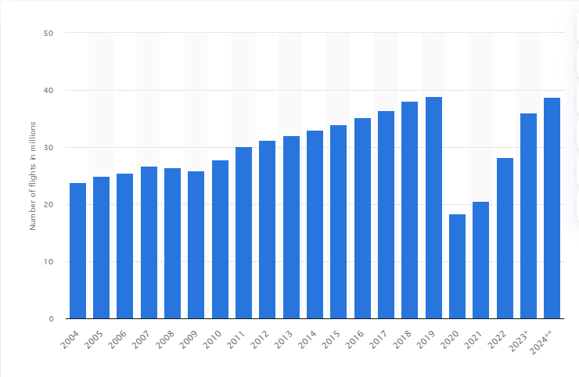
Growth of the Airline Industry:
The airline industry has experienced significant growth over the past decade, driven by increasing travel demand and globalization.
This chart highlights the upward trend in passenger numbers and revenue, emphasizing the industry's economic significance.

Slide 3

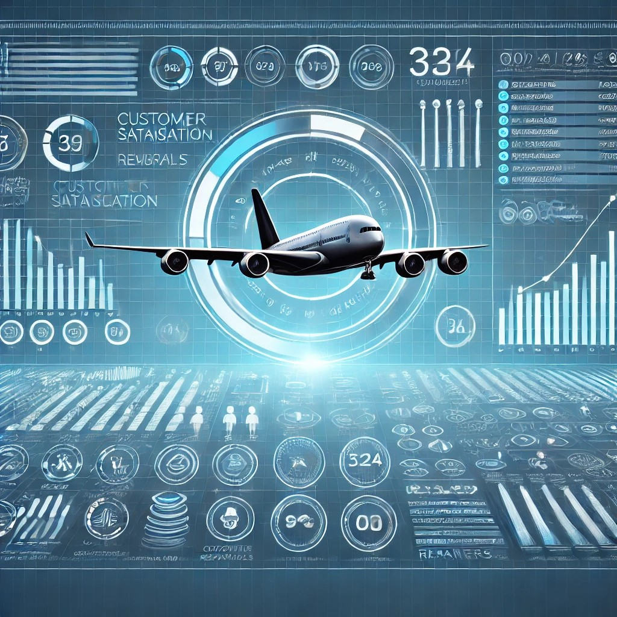
Happy Customer Interaction:
Customer satisfaction is paramount for airlines.
This image showcases the importance of positive interactions between airline employees and passengers, contributing to a pleasant travel experience and fostering customer loyalty.

Slide 4
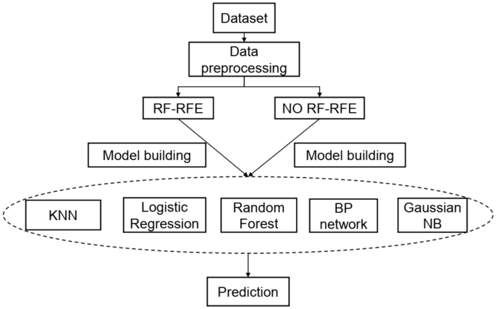
Machine Learning Model
Our project utilizes a machine learning model to predict passenger referrals. This visual representation illustrates the model's architecture and the key features used to make accurate predictions, enabling airlines to identify potential referrers effectively.

Slide 5
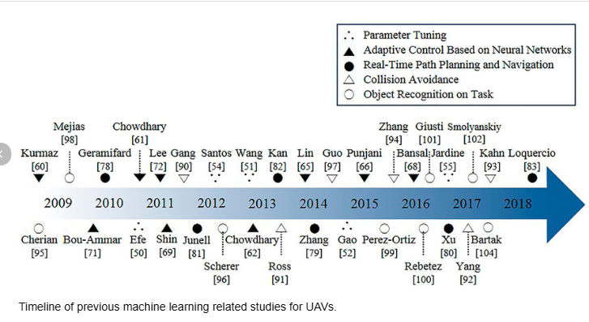
Timeline of Machine Learning in Airlines
Machine learning has been gradually integrated into the airline industry over the past 10 years. This timeline highlights key milestones, showcasing the evolution of its applications, from predicting flight delays to personalizing customer recommendations.

Slide 6
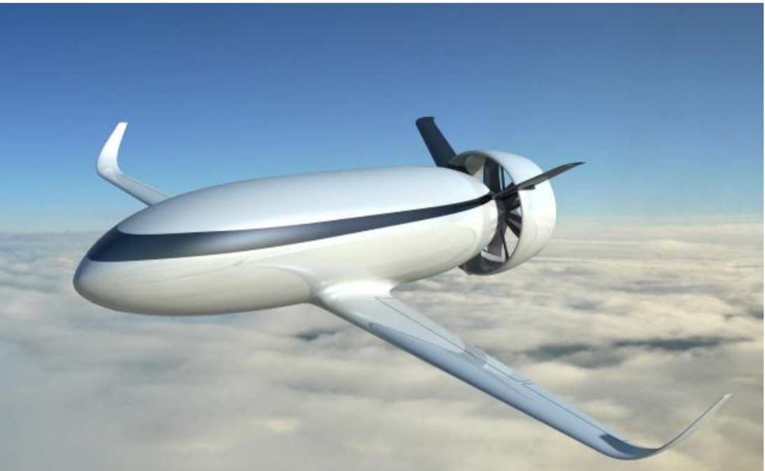
Expectations for 2025
Futuristic Airplane: "The future of air travel will be shaped by advanced technologies, including machine learning. This image depicts a futuristic airplane equipped with intelligent systems, showcasing the potential for enhanced safety, efficiency, and passenger comfort”.

Slide 7
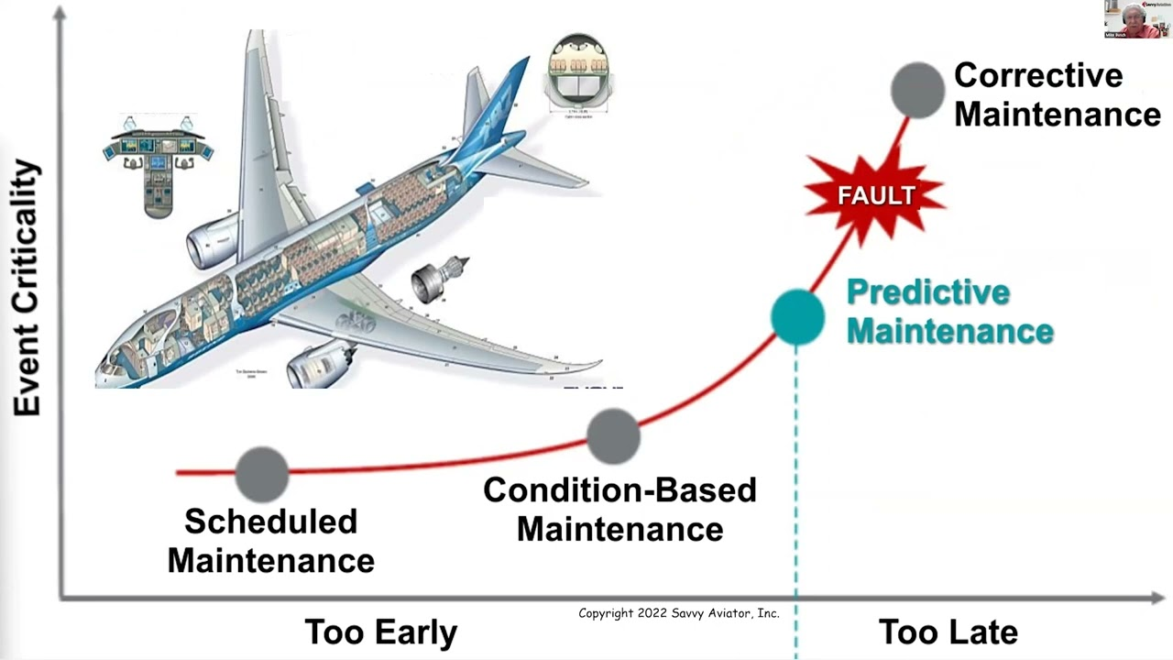
Predictive Maintenance Diagram
"Machine learning can revolutionize aircraft maintenance. This diagram illustrates the benefits of using predictive maintenance, enabling airlines to identify potential issues before they occur, minimizing downtime, and ensuring safer operations."

Slide 8

Airline Passenger Referral Prediction.

